Slide 1
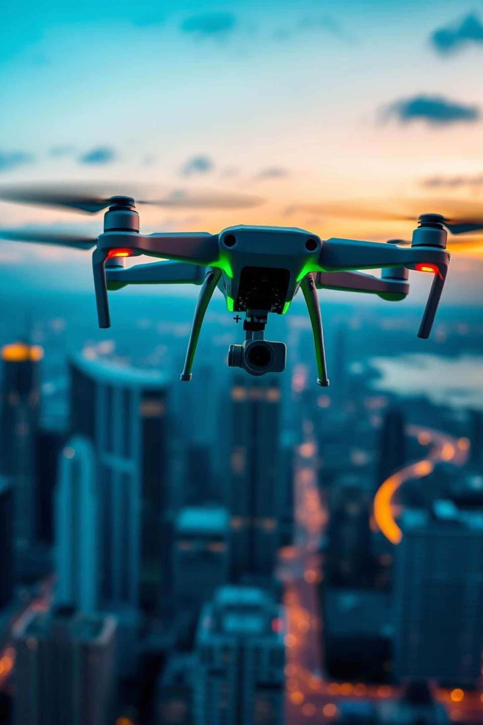
Drone Detection and Tracking System
Powered by YOLO and Deep SORT
Submitted By :
Anant Pratap Singh
Nitish Biswas
Swastika Bera
Submitted To :
The Comandant Under The Super Vision Of :
Lt. Col Shantind Dhingra
DYGM(P) TL
509 Army Base Workshop

Slide 2
Introduction and Motivation
Project Goal
Motivation
Develop an automated, real-time system for drone detection and tracking. This project aims to significantly enhance security and airspace management through advanced computer vision techniques.
The increasing proliferation of drones presents significant safety and privacy challenges. Traditional manual monitoring methods are inefficient and prone to errors, necessitating an automated, real-time surveillance solution, especially in sensitive areas like airports or critical infrastructure.
Why Automated?
Enhanced Security
Airspace Management
Manual surveillance is resource-intensive and often misses critical events, making it unsuitable for the dynamic nature of drone operations.
Automated systems provide continuous, objective monitoring, reducing human error and improving response times to potential threats.
Efficient tracking of authorized and unauthorized drones is crucial for preventing conflicts and maintaining airspace integrity.
509 Army Base Workshop

Slide 3
System Overview: Architecture
Our drone detection and tracking system leverages cutting-edge computer vision algorithms to provide real-time surveillance. The architecture is designed for efficiency and accuracy, integrating distinct components for detection and tracking.
Input
Live video feed from CCTV cameras or recorded footage from various sources.
Detection
YOLO (You Only Look Once) model for rapid and accurate drone recognition.
Tracking
Deep SORT (Simple Online and Realtime Tracking with a Deep Association Metric) for maintaining identities of detected drones across frames.
Output
Real-time visualization of drone locations, bounding boxes, and trajectories.
509 Army Base Workshop

Slide 4


YOLO: The Detection Engine
You Only Look Once
YOLO is a deep learning-based object detection algorithm renowned for its exceptional speed while maintaining high accuracy. Unlike traditional methods that process regions of an image sequentially, YOLO processes the entire image in a single forward pass through a convolutional neural network.
Real-time Performance: Simultaneously predicts bounding boxes and class probabilities.
Unified Detection: No separate steps for region proposal and classification, leading to faster inference.
End-to-End Learning: Directly learns features from the entire image, improving contextual understanding.
YOLO's ability to achieve real-time performance is crucial for applications like drone detection, where swift identification of threats or anomalies is paramount.

Slide 5
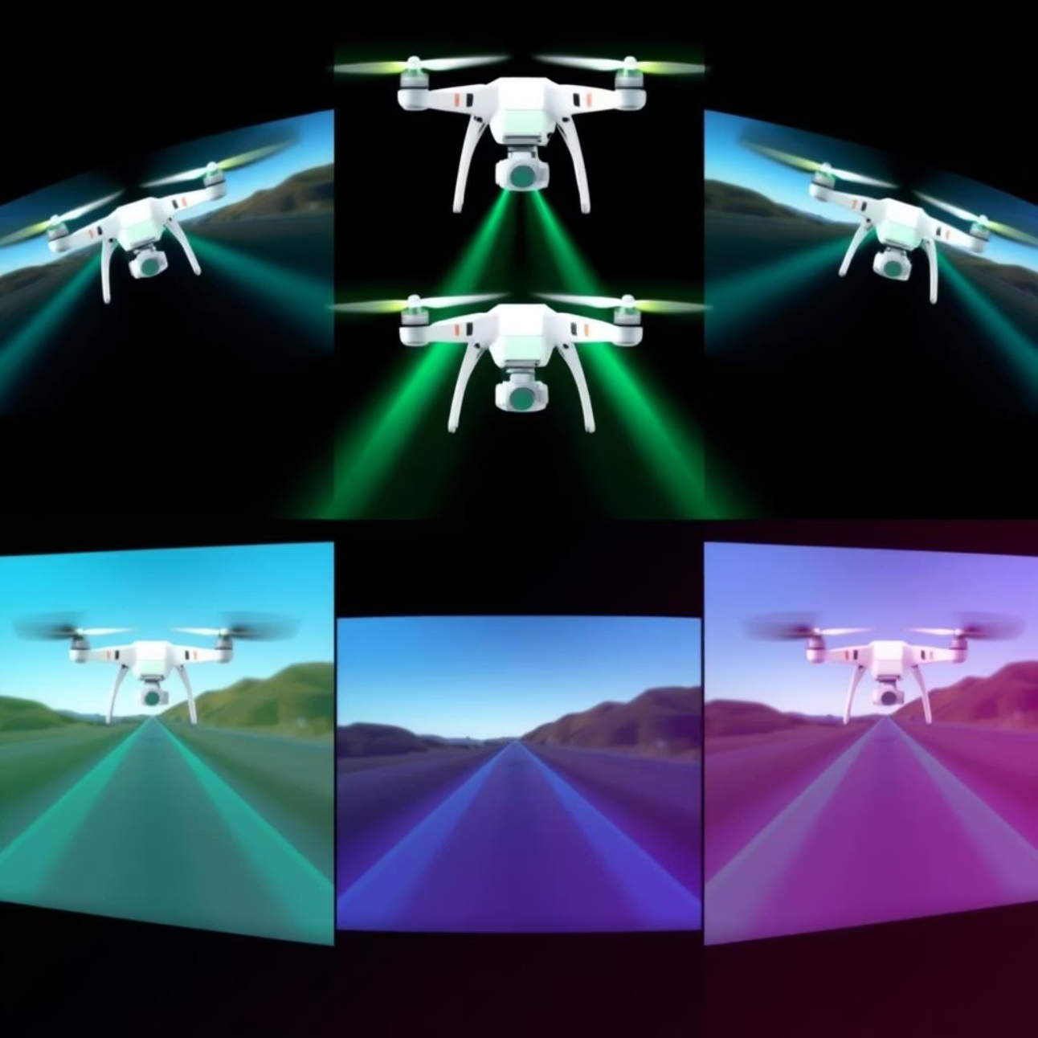
Deep SORT: Robust Tracking
Deep SORT (Realtime Tracking): A multi-object tracking algorithm
Deep SORT extends the SORT algorithm by incorporating a deep learning association metric, significantly enhancing its ability to maintain unique identities for objects even in challenging scenarios.
Identity Preservation: Assigns and maintains unique IDs for each drone.
Occlusion Handling: Robustly tracks objects through partial or full occlusions using appearance features.
Motion and Appearance: Combines Kalman filter-based motion prediction with a deep appearance descriptor for highly accurate association.
This allows for seamless tracking of multiple drones, providing continuous information on their movement and behavior, which is essential for comprehensive airspace monitoring.
509 Army Base Workshop

Slide 6




How the System Works: A Workflow
The entire system operates as a cohesive pipeline, ensuring efficient and continuous drone surveillance.
1. Video Capture
2. Drone Detection
High-definition video streams are continuously fed into the system from various sources, including dedicated CCTV drone cameras positioned strategically around the monitored area.
Each video frame undergoes rapid analysis by the YOLO model. It identifies drones within the frame, drawing precise bounding boxes and assigning confidence scores to each detection.
3. Object Tracking
4. Real-time Output
Detected drones are then passed to the Deep SORT algorithm. It assigns a unique identity to each drone and tracks its movement across successive frames, predicting its trajectory.
The final output is displayed in real-time, showing detected drones with their unique IDs, bounding boxes, and predicted trajectories. This provides immediate situational awareness.
This seamless integration ensures that drone activities are continuously monitored, providing actionable intelligence for security personnel.
509 Army Base Workshop

Slide 7
Key Advantages and Applications
Advantages
Applications
High Accuracy
The versatility of this system makes it suitable for a wide range of critical applications where drone detection and tracking are paramount:
YOLO's advanced architecture provides fast, high-precision drone detections, minimizing false positives and negatives.
Airport Surveillance: Protecting restricted airspace from unauthorized drone intrusions.
Real-time Tracking
Critical Infrastructure Protection: Securing power plants, dams, and sensitive facilities from aerial threats.
Deep SORT ensures continuous and robust tracking of multiple drones, even in dynamic and crowded environments, maintaining identity across occlusions.
Event Security: Monitoring large public gatherings to prevent illegal drone activities.
Wildlife Monitoring: Non-intrusive observation and tracking of animal populations for conservation efforts.
Scalability
Border Patrol: Detecting and tracking drones used for illicit activities across national borders.
The modular design allows for deployment across multiple camera systems and integration into large-scale surveillance networks, covering extensive geographical areas.
Industrial Site Safety: Monitoring construction sites or industrial zones for unauthorized aerial vehicles.
509 Army Base Workshop

Slide 8
Challenges and Future Direction
Current Challenges
Future Enhancements
Environmental Variability: Performance can be affected by variable lighting, adverse weather conditions (rain, fog), and complex backgrounds.
Alerting System Integration: Seamless integration with existing security and alerting systems for immediate threat notification.
Drone Characteristics: Detection and tracking of very tiny or extremely fast-moving drones remain a challenge due to resolution and processing speed limits.
Night Detection: Incorporating thermal camera data and infrared sensors for robust detection capabilities during nighttime operations.
Edge Device Optimization: Further optimization of algorithms and models for deployment on resource-constrained edge devices, enabling localized processing and faster response times.
Occlusions: Handling prolonged occlusions in highly cluttered environments can sometimes lead to identity switches or temporary loss of track.
This system represents a significant step forward in automated drone surveillance, continuously evolving to meet new challenges.
Conclusion
The implemented system, leveraging the power of YOLO for detection and Deep SORT for tracking, offers an effective and real-time solution for drone surveillance. Its potential to greatly improve safety and situational awareness in sensitive airspaces is immense, providing a foundation for next-generation security protocols.
509 Army Base Workshop

Slide 9
Thank You
509 Army Base Workshop

